Slide 1



UNIT 3: School
An interview

Slide 2
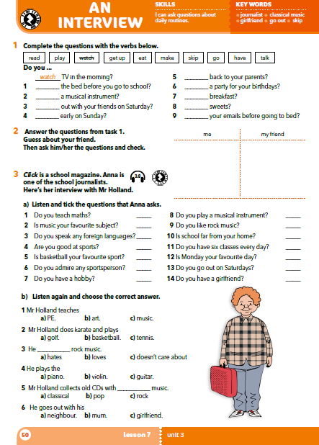
Who is this interview with?
Look at the key words – what is the interview about?

Slide 3
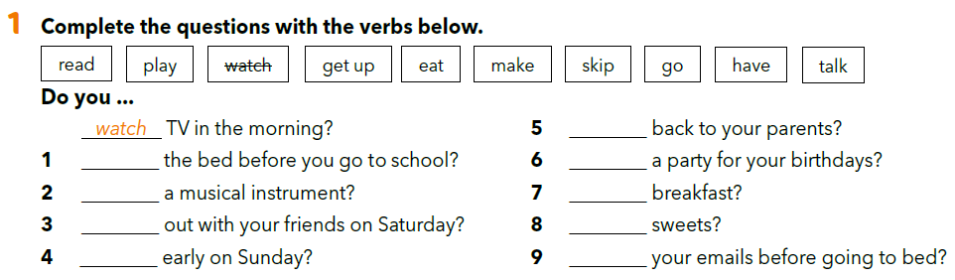
talk
make
have
play
skip
skip = preskočiti
go
eat
get up
read

Slide 4
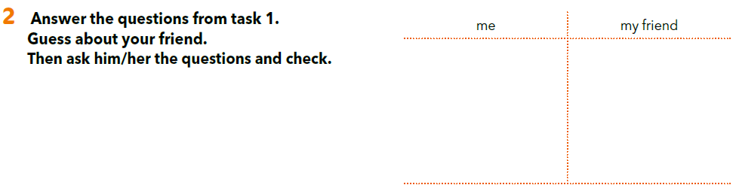

Slide 5
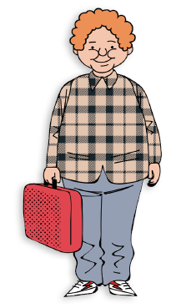
Look at the picture and answer the questions.
Who is this ? Guess.
What does he look like?
What is he look like?
What does he do?
What are his hobbies?

Slide 6

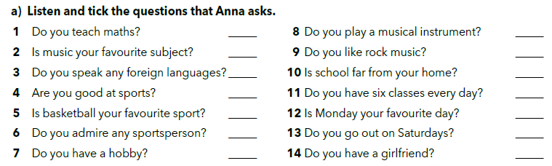






https://www.e-sfera.hr/dodatni-digitalni-sadrzaji/b8393074-eceb-41dc-9a29-b4961c2d41e2/assets/audio/26_mr_holland.mp3

Slide 7
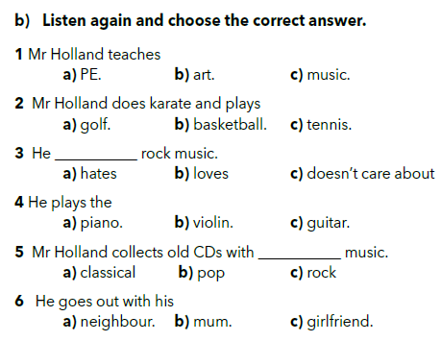
https://www.e-sfera.hr/dodatni-digitalni-sadrzaji/b8393074-eceb-41dc-9a29-b4961c2d41e2/assets/audio/26_mr_holland.mp3
girlfriend = djevojka

Slide 8
Let’s revise!
Fill in the gaps with the correct words.
https://wordwall.net/embed/396f96448cff4d9ea97762817d76c23d?themeId=46&templateId=36%27%20frameborder=%270

Slide 9
Osmisli intervju sa savršenim učiteljem. U intervjuu upotrijebi najmanje 8 pitanja, a odgovori trebaju biti pune rečenice. Možeš koristiti pitanja iz udžbenika. Napiši intervju (pitanja i odgovore) u bilježnicu.
Tko želi, i ako učitelj/ica na to pristane, može osmisliti pitanja i intervjuirati učitelja/icu koja im predaje, a kojemu se dive.

Slide 10
What elements should be in your work?
Who is the interview supposed to be with?
How many questions should there be?
Are ”yes or no” answers good enough?
Should the interview be creative?
A perfect teacher.
At least 8 questions.
No, you should write the answers in full sentences.
Yes.

Slide 11
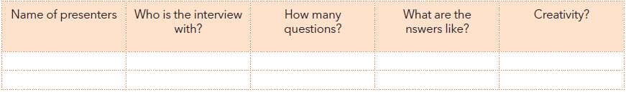
Listen to your friends’ interviews.
a

Slide 12
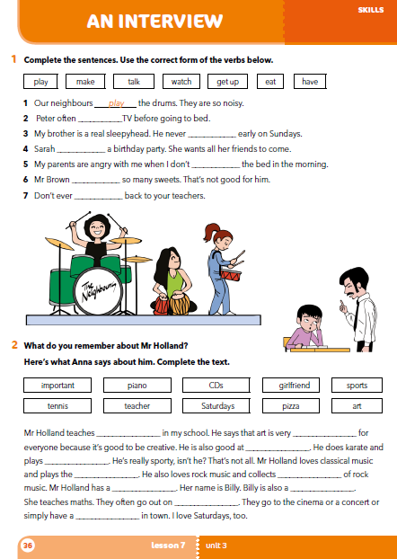
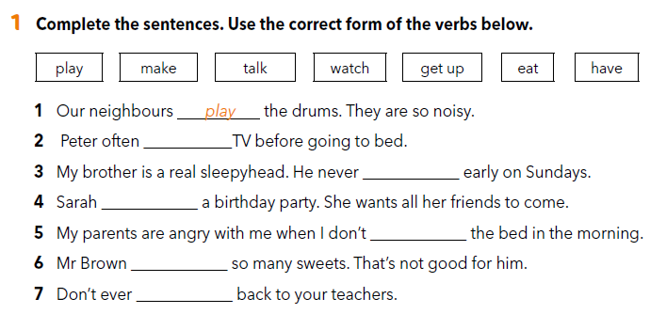
Workbook p 36.
watches
gets up
has
make
eats
talk

Slide 13
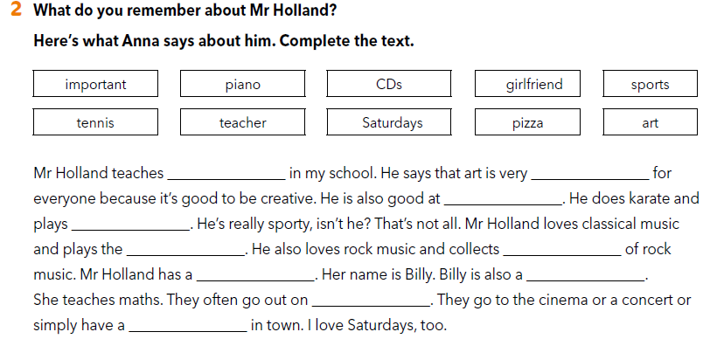
art
important
sports
tennis
piano
CDs
girlfriend
teacher
Saturdays
pizza

Slide 14

LEARN MORE
https://www.e-sfera.hr/dodatni-digitalni-sadrzaji/b8393074-eceb-41dc-9a29-b4961c2d41e2/
A school interview

